Slide 1
CSC 222: Computer Organization & Assembly Language
2 – Data Representation
Instructor: Anwar khan

Slide 2
Number System
Any number system using a range of digits that represents a specific number. The most common numbering systems are decimal, binary, octal, and hexadecimal.
Numbers are important to computers
represent information precisely
can be processed
For example:
to represent yes or no: use 0 for no and 1 for yes
to represent 4 seasons: 0 (autumn), 1 (winter), 2(spring) and 3 (summer)

Slide 3
Positional Number System
A computer can understand positional number system where there are only a few symbols called digits and these symbols represent different values depending on the position they occupy in the number.
A value of each digit in a number can be determined using
The digit
The position of the digit in the number
The base of the number system (where base is defined as the total number of digits available in the number system).

Slide 4
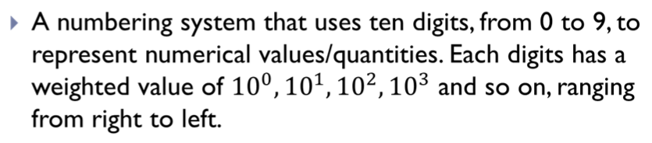
Decimal Number System

Slide 5
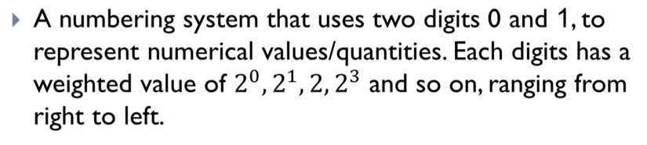
Binary Number System

Slide 6
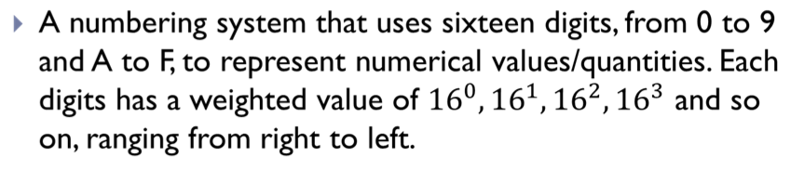
Hexadecimal Number System

Slide 7
Conversion Between Number Systems
Converting Hexadecimal to Decimal
Multiply each digit of the hexadecimal number from right to left with its corresponding power of 16.
Convert the Hexadecimal number 82ADh to decimal number.

Slide 8
Conversion Between Number Systems
Converting Binary to Decimal
Multiply each digit of the binary number from right to left with its corresponding power of 2.
Convert the Binary number 11101 to decimal number.

Slide 9
Conversion Between Number Systems
Converting Decimal to Binary
Divide the decimal number by 2.
Take the remainder and record it on the side.
REPEAT UNTIL the decimal number cannot be divided into anymore.

Slide 10
Conversion Between Number Systems
Converting Decimal to Hexadecimal
Divide the decimal number by 16.
Take the remainder and record it on the side.
REPEAT UNTIL the decimal number cannot be divided into anymore.

Slide 11
Conversion Between Number Systems
Converting Hexadecimal to Binary
Given a hexadecimal number, simply convert each digit to it’s binary equivalent. Then, combine each 4 bit binary number and that is the resulting answer.
Converting Binary to Hexadecimal
Begin at the rightmost 4 bits. If there are not 4 bits, pad 0s to the left until you hit 4. Repeat the steps until all groups have been converted.

Slide 12
Binary Arithmetic Operations
Addition
Like decimal numbers, two numbers can be added by adding each pair of digits together with carry propagation.
11001
+ 10011
101100
647
+ 537
1184
Binary Addition
Decimal Addition

Slide 13
Binary Arithmetic Operations
Subtraction
Two numbers can be subtracted by subtracting each pair of digits together with borrowing, where needed.
11001
- 10011
00110
627
- 537
090
Binary Subtraction
Decimal Subtraction

Slide 14
MSB and LSB
In computing, the most significant bit (msb) is the bit position in a binary number having the greatest value. The msb is sometimes referred to as the left-most bit.
In computing, the least significant bit (lsb) is the bit position in a binary integer giving the units value, that is, determining whether the number is even or odd. The lsb is sometimes referred to as the right-most bit.

Slide 15
Unsigned Integers
An unsigned integer is an integer at represent a magnitude, so it is never negative.
Unsigned integers are appropriate for representing quantities that can be never negative.

Slide 16
Signed Integers
A signed integer can be positive or negative.
The most significant bit is reserved for the sign:
1 means negative and 0 means positive.
Example:
00001010 = decimal 10
10001010 = decimal -10

Slide 18
One’s Complement
The one’s complement of an integer is obtained by complementing each bit, that is, replace each 0 by a 1 and each 1 by a 0.

Slide 19
2’s Complement
Negative integers are stored in computer using 2’s complement.
To get a two’s complement by first finding the one’s complement, and then by adding 1 to it.
Example
11110011 (one's complement of 12)
+ 00000001 (decimal 1)
11110100 (two's complement of 12)

Slide 20
Subtract as 2’s Complement Addition
Find the difference of 12 – 5 using complementation and addition.
00000101 (decimal 5)
11111011 (2’s Complement of 5)
00001100 (decimal 12)
+ 11111011 (decimal -5)
00000111 (decimal 7)
No Carry

Slide 21
Example
Find the difference of 5ABCh – 21FCh using complementation and addition.
5ABCh = 0101 1010 1011 1100
21FCh = 0010 0001 1111 1100
1101 1110 0000 0100 (2’s Complement of 21FCh)
0101 1010 1011 1100 (Binary 5ABCh)
+ 1101 1110 0000 0100 (1’s Complement of 21FCh)
10011 1000 1100 0000
Discard Carry

Slide 22
Decimal Interpretation
How to interpret the contents of a byte or word as a signed and unsigned decimal integer?
Unsigned decimal interpretation
Simply just do a binary to decimal conversion or first convert binary to hexadecimal and then convert hexadecimal to decimal.
Signed decimal interpretation
If msb is zero then number is positive and signed decimal is same as unsigned decimal.
If msb is one then number is negative, so call it -N. To find N, just take the 2’s complement and then convert to decimal.

Slide 23
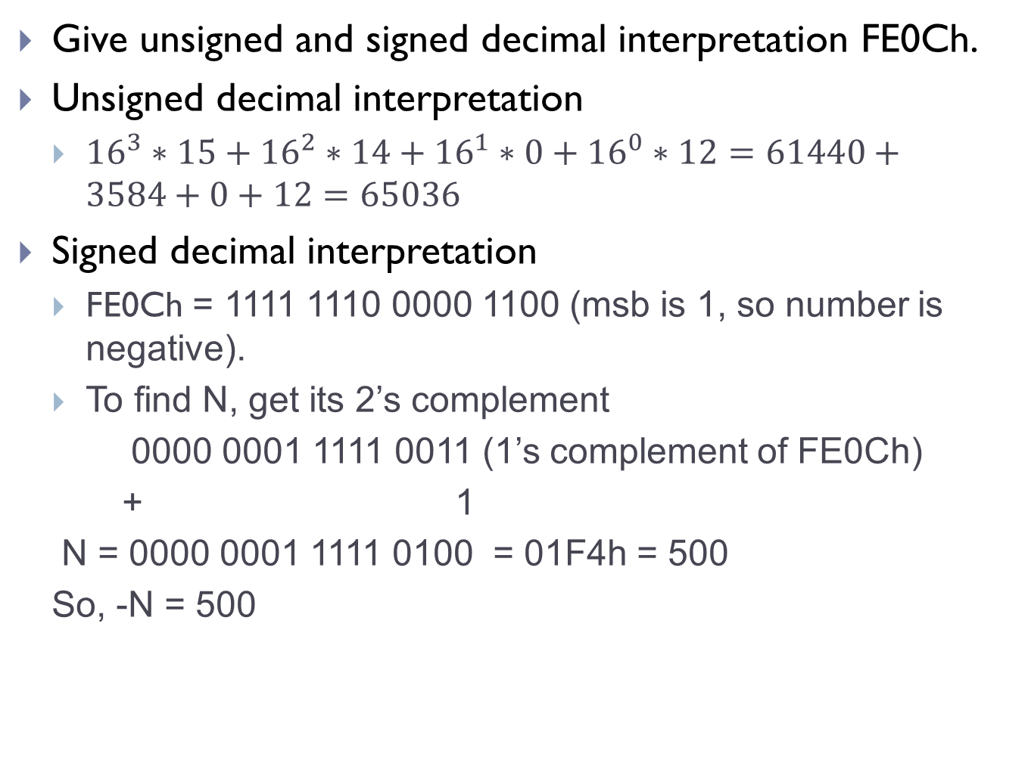
Example
Give unsigned and signed decimal interpretation FE0Ch.
Unsigned decimal interpretation
${16}^{3}∗15+{16}^{2}∗14+{16}^{1}∗0+{16}^{0}∗12=61440+3584+0+12=65036$
Signed decimal interpretation
FE0Ch = 1111 1110 0000 1100 (msb is 1, so number is negative).
To find N, get its 2’s complement
0000 0001 1111 0011 (1’s complement of FE0Ch)
+ 1
N = 0000 0001 1111 0100 = 01F4h = 500
So, -N = 500

Slide 24
Decimal Interpretation
For 16 – bit word, following relationships holds between signed and unsigned decimal interpretation
From 0000h – 7FFFh, signed decimal = unsigned decimal
From 8000h – FFFFh, signed decimal = unsigned decimal – 65536.
Example:
Unsigned interpretation of FE0Ch is 65036.
Signed interpretation of FE0Ch = 65036 – 65536 = -500.

Slide 25
Binary, Decimal, and Hexadecimal Equivalents.

Slide 26
Character Representation
All data, characters must be coded in binary to be processed by the computer.
ASCII:
American Standard Code for Information Interchange
Most popular character encoding scheme.
Uses 7 bit to code each character.
2⁷ = 128 ASCII codes.
Single character Code = One Byte [7 bits: char code, 8th bit set to zero]
32 to 126 ASCII codes: printable
0 to 31 and 127 ASCII codes: Control characters

Slide 27
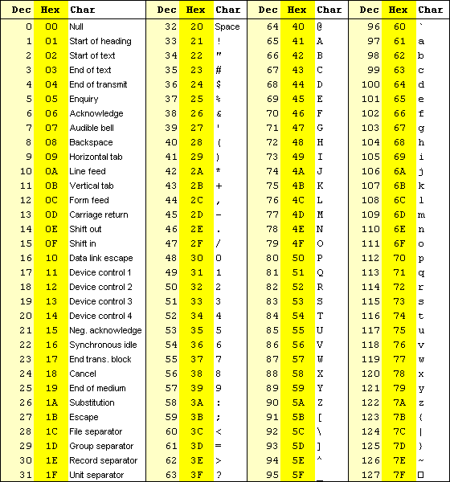

Slide 28
How to Convert?
If a byte contains the ASCII code of an uppercase letter, what hex should be added to it to convert to lower case?
Solution: 20 h
Example: A (41h) a (61 h)
If a byte contains the ASCII code of a decimal digit, What hex should be subtracted from the byte to convert it to the numerical form of the characters?
Solution: 30 h
Example: 2 (32 h)

Slide 29
Character Storage
ASCII Representation of “123” and 123

